Slide 1
Predicting Flight Delays
Team 08
Ajeya Tarikere Jayaram, Kumar Narayanan, Mrinal Chawla, Sushant Joshi
W261: Machine Learning at scale
Section 5
Instructor: Ramki Gummadi

Slide 2
Business Case
$40 Billion
Impact of US domestic flights delay
Plan Travel
Customer Experience
Notes:
Mrinal

Slide 3
Problem Statement
Predict two hours prior to a flight’s departure time whether the flight will be delayed.
Notes:
Mrinal
Classification problem
Evaluate with ROC curve due to imbalance in predicting class
Use AUC to compare model to model

Slide 4
Datasets
Airlines Dataset
US Department of Transportation
Weather Dataset
National Oceanic and Atmospheric Administration repository
31,746,841 flight information
109 features
630,904,436 weather recordings
177 features
Weather Stations Dataset
5,004,169 records of connection between stations
2,237 distinct stations
Notes:
Ajeya
We have three datasets with data from 2015-2019 - the airlines dataset, the weather dataset and weather stations. The airlines dataset has features related to the time of the flight’s departure, the origin and destination airports, features related to the carrier and the flight. The weather dataset has weather recordings such as wind, visibility, pressure, temperature captured periodically at different stations and the weather stations dataset has geolocation information of the weather stations and their distance to other stations.

Slide 5
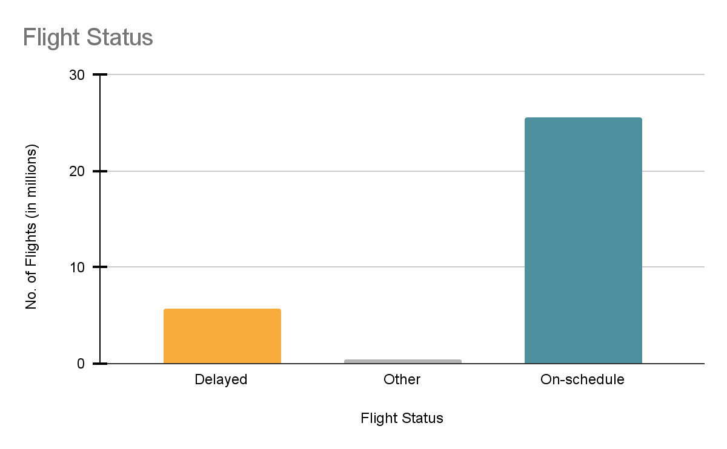
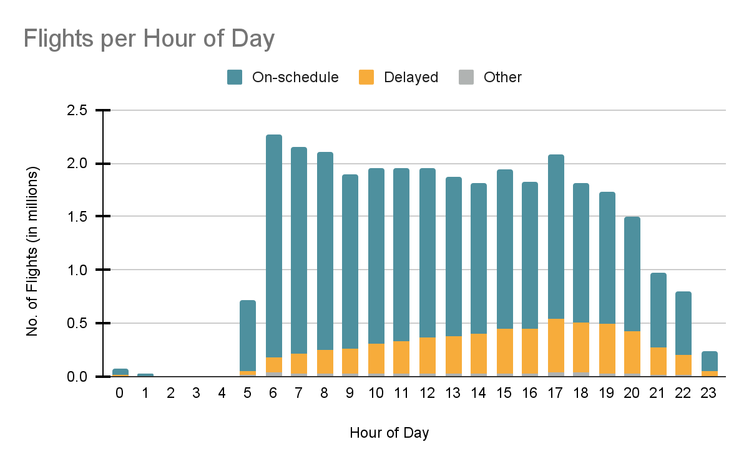
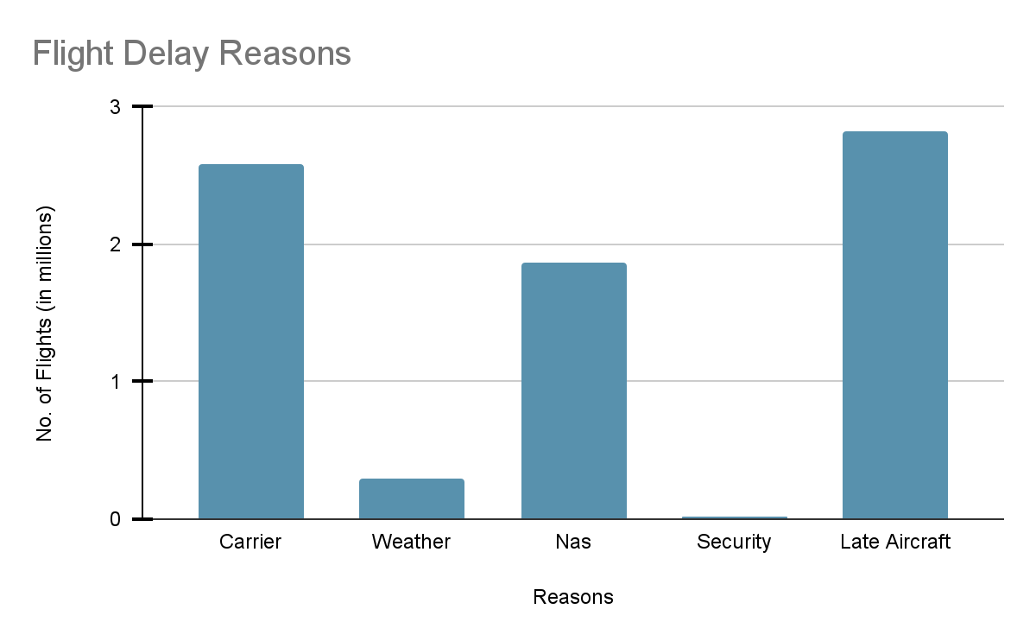
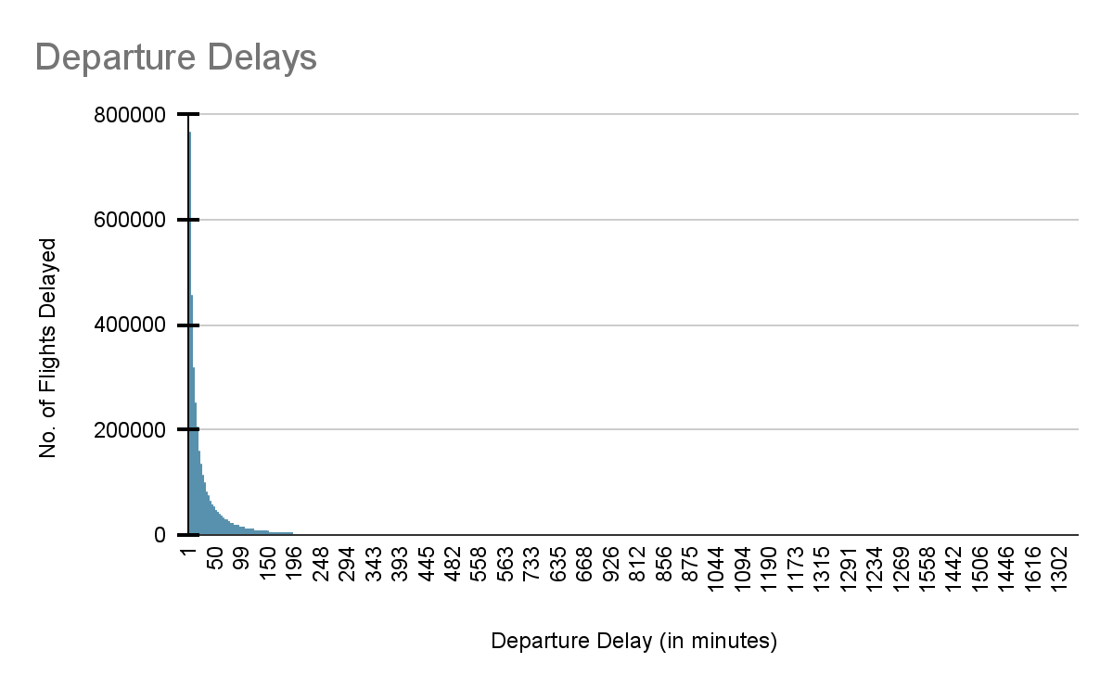
EDA - Airlines
Notes:
Ajeya
Our EDA on the airlines dataset reveals that there is an imbalance between the number of flights that are delayed and the number of flights that were on-schedule.
The causes of flight delays reveals that the major reasons for delays are either due to the carrier or the aircraft itself and weather plays a minor role in determining whether flights would be delayed. We cannot however discount weather altogether because major events such as tornadoes, hurricanes, snow storms could cause air traffic to be affected even at airports where weather conditions are good.
We also find that the hour of the day during which the flight departs plays a significant role in deciding whether flights may be delayed.
Talk about dimension reductions and what features we used based on this analysis

Slide 6
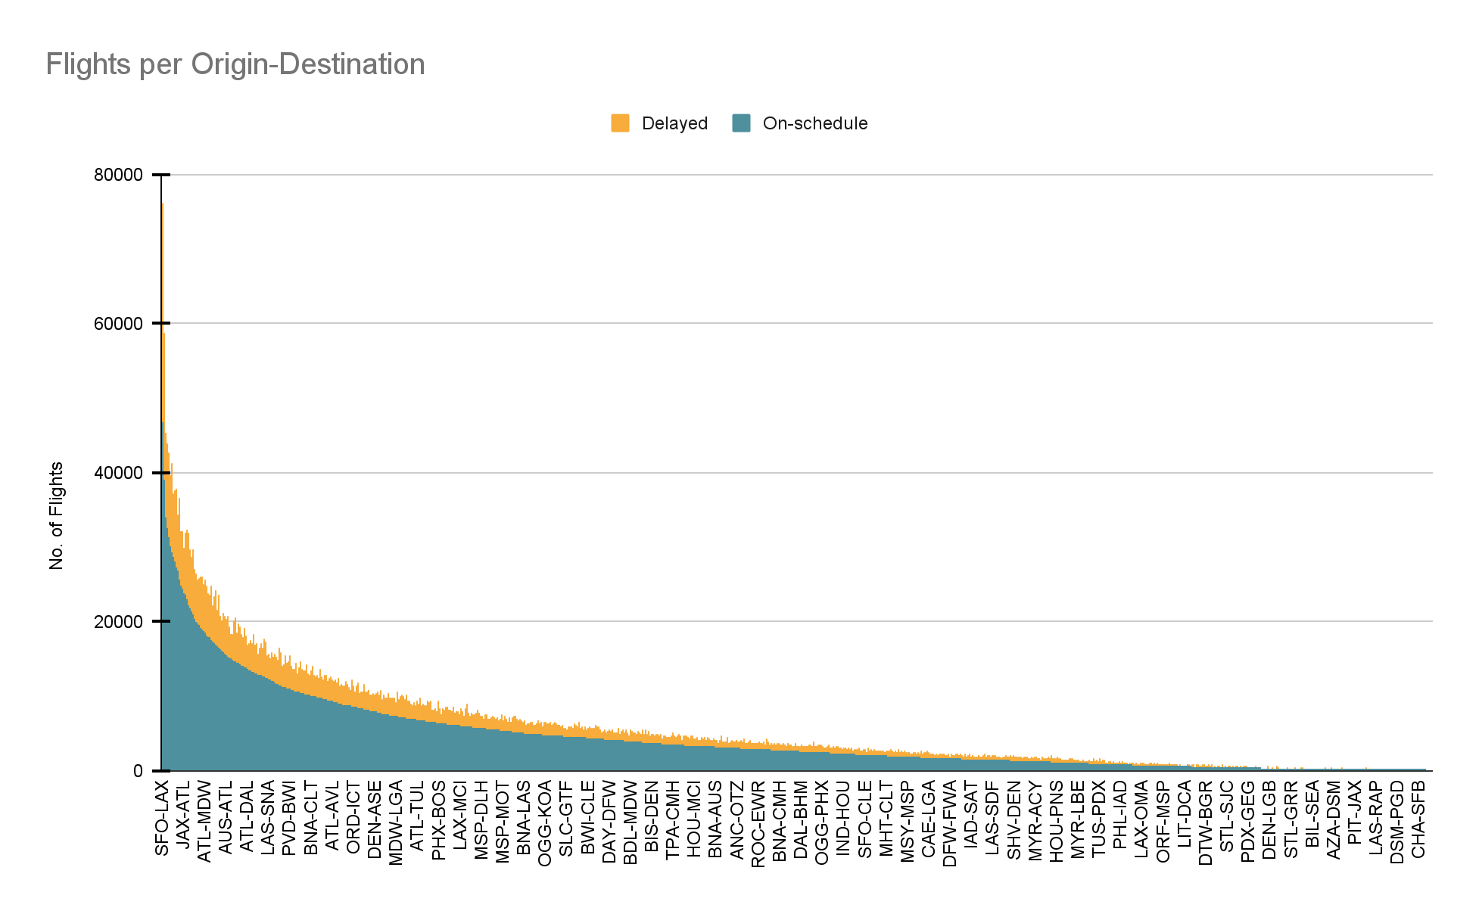
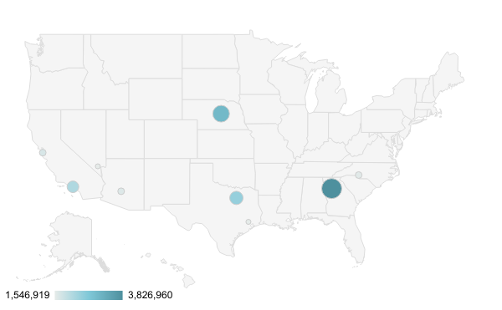
EDA - Airlines
Top 10 Airports by Number of Flights
Notes:
Ajeya
We also find out from the airlines dataset that the busiest flight sectors also tend to have more flight delays.

Slide 7
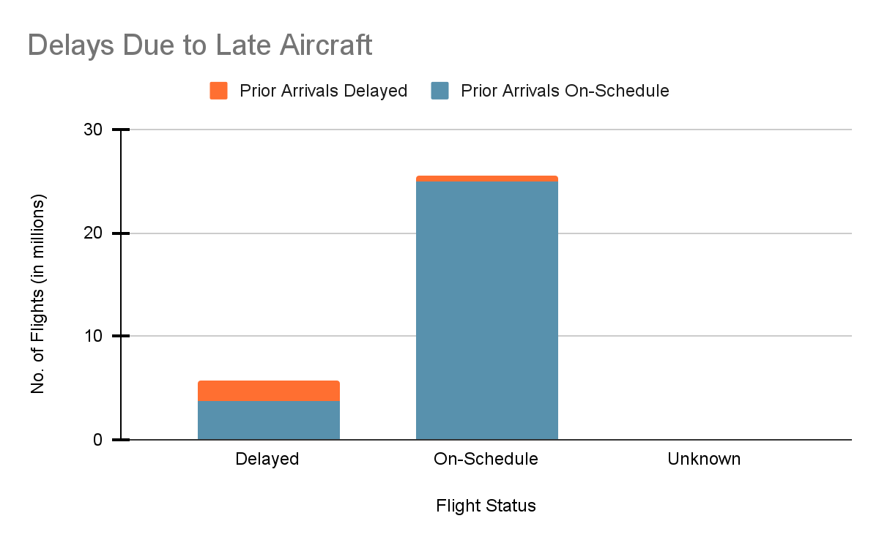
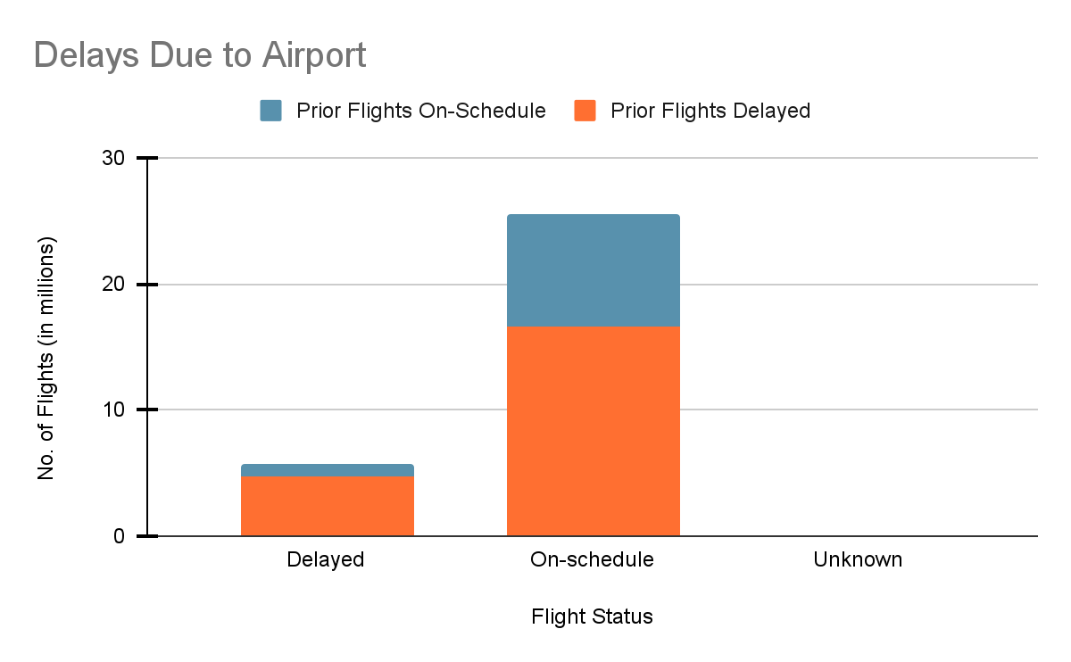
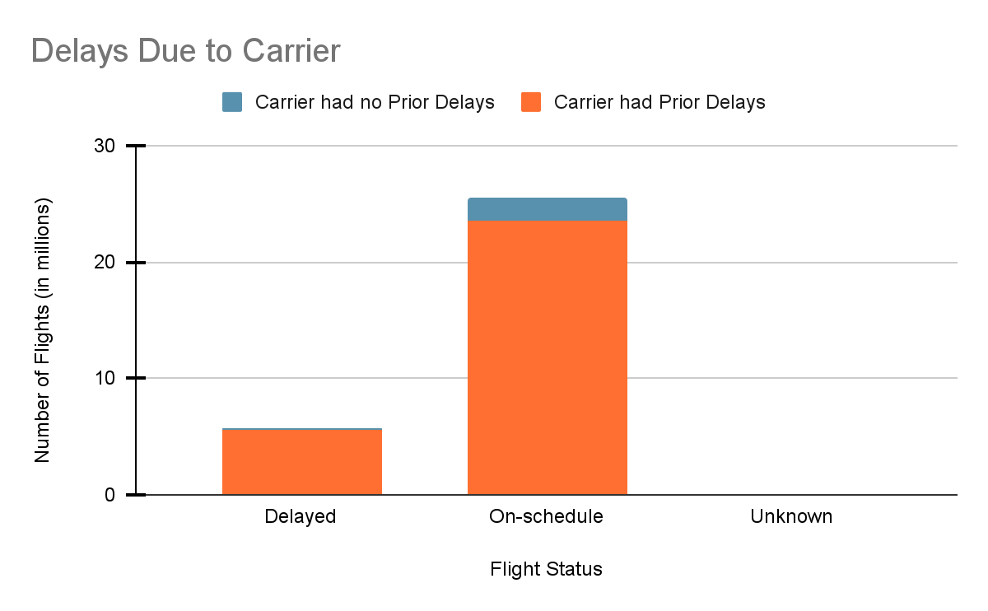
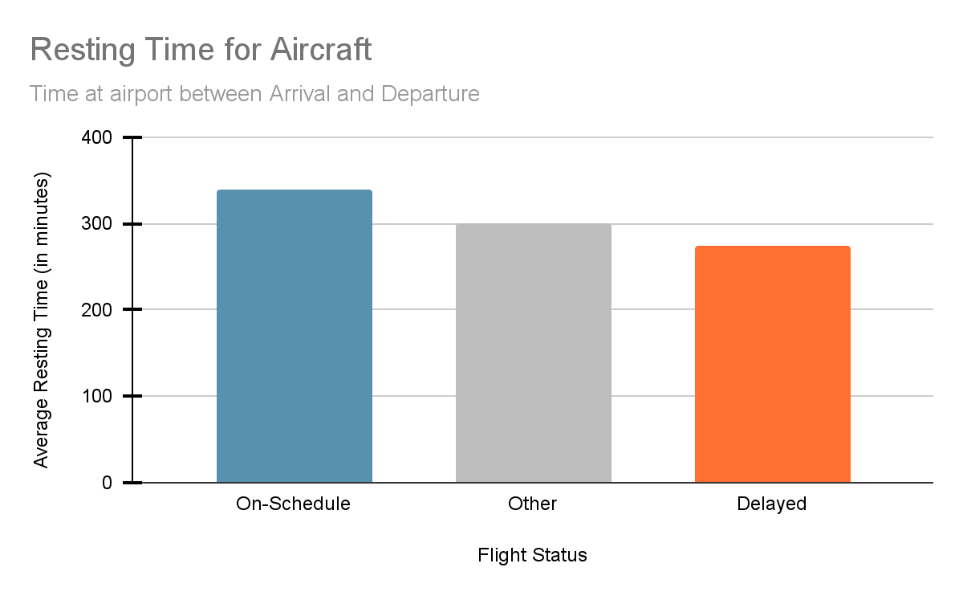
EDA - Airlines
Notes:
Ajeya
Based on the different causes of delays we saw earlier, we try to see how these delays in a 2 hr window 2 hours prior to the departure time affect the flight’s departure status.
We see that delayed aircrafts tend to have more arrival delays for an aircraft 2 hrs prior to its scheduled departure.
Similarly, delayed aircrafts tend to have more departure delays due to the carrier and delays due to airport in the 2 hrs prior to scheduled departure than those that are on-schedule.
Also, we measure the average time an aircraft spends at the airport between its arrival and the next departure. We call this the resting time for aircraft. We see that delayed aircrafts have a mean resting time less than aircrafts that departed as scheduled.

Slide 8
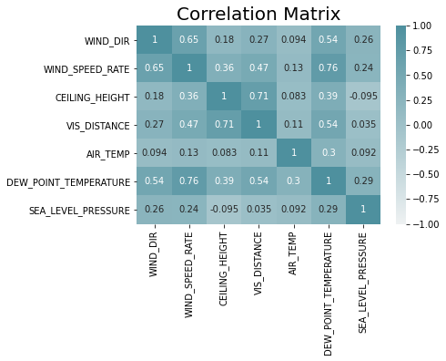
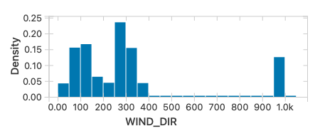
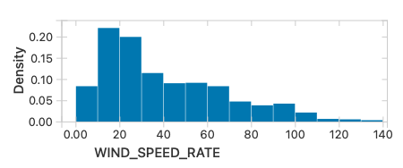
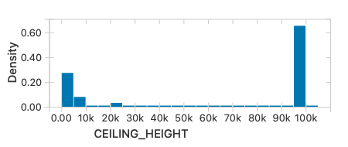
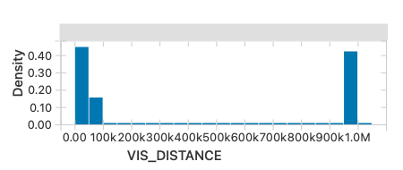
EDA - Weather
Notes:
Ajeya
From the weather data set, we extract different weather measurements such as wind rate, wind direction, visibility distance, ceiling height, air temperature, dew point temperature, sea level pressure. Plotting a correlation matrix, reveals some strong correlation between visible distance and ceiling height, dew point temperature and wind speed rate. On the histograms you can see that some of the features show extreme values. These are actually missing values represented as 9999, 99 or 999.

Slide 9
Feature Set
Feature Groups | Features
Weather | Temperature, Snow, Snow Depth, Rain, Drizzle, Fog, Mist, Thunder, Tornado, Gust, Wind, Wind Type, Sea Level Pressure, Past and Present Weather Conditions
Flight | Flight Duration, Carrier, Origin, Destination
Time Based Features | Hour of the Day, Day of the Month, Month of the Year, Holidays / Peak Season (July 4th, Christmas, ThanksGiving), Weekday / Weekend
Delay Based Features | Number and Percentage of Prior Arrival Delays for Aircraft, Number and Percentage of Prior Delays at Origin Airport, Number and Percentage of Prior Delays for Carrier
Notes:
Sushant
Total count: 147 (with one hot encoding)

Slide 10
Feature Engineering
Feature identification & extraction
Columns with multiple features extracted to single columns
Dropping Features
Many features had too many missing values
Imputation
Average of past 15 days used to replace missing values
Feature Encoding
Categorical features One-Hot encoded
New Features
Precipitation rate
Local departure hour
Count and % of arrival delay by tail number
Count and % of departure delay by origin
Notes:
Sushant
Dropped features : Some examples, Cloud Cover Type, Extreme Air Temperature indicator
Imputation: Used past 720 records, which is roughly past 15 days
Varies since stations have different numbers of recordings per hour

Slide 11





Dataset Join
Airlines
6 AM
8 AM
10 AM
Closest weather station to airport
Weather readings at weather station
Weather
Weather window
Notes:
Sushant

Slide 12
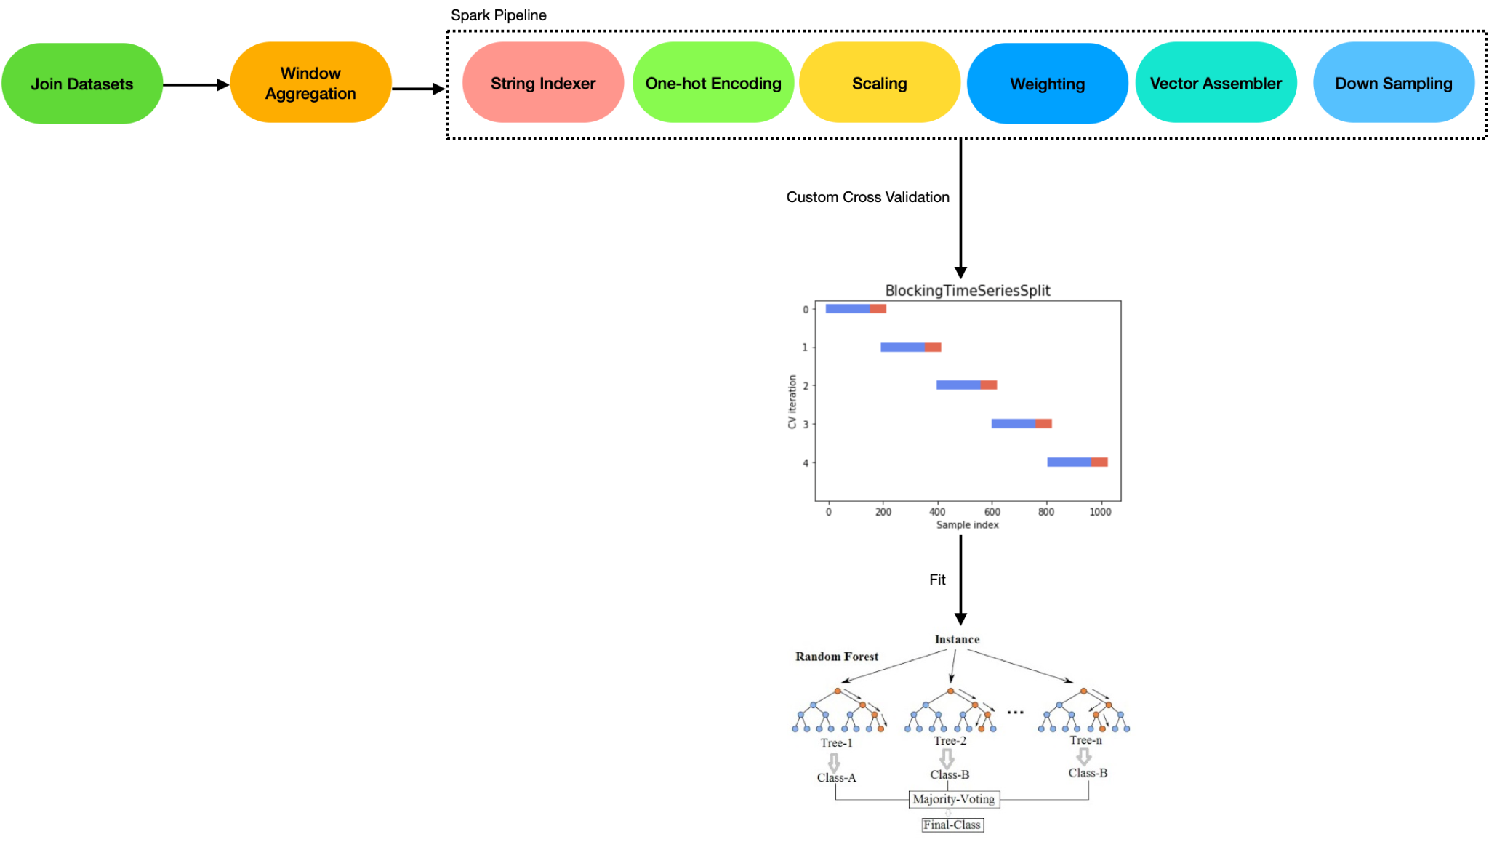
Model Workflow Overview
Time Series Image source: https://miro.medium.com/max/1210/1*QJaeOqGfe_vKbpmT882APA.png
Random Forest Image Source: https://knowledgebase.hyperlearning.ai/user/pages/01.knowledgebase/article-real-time-machine-learning-pipeline-with-apache-spark/random-forest-overview.jpg
Notes:
Kumar

Slide 13
Data Preparation Flow
Joined Dataset
Aggregate Window
Assemble Features
Downsample / Weighting
One Hot Encoding
Scaling
Prepared Data
Notes:
Kumar
OHE and Scaling used for regression models
Downsampling / weighting achieve same purpose and use only one
Should be 50-50 split for downsampling.

Slide 14
Model Summary
 | Logistic Regression | Logistic Regression with weights | Gradient Boosted Trees | XGBoost | Ensemble | Random Forest
Description | 2-class classifier using numeric features | Useful in high skew situations | Able to learn iteratively at each step | Speed improvement over GBT | Should provide benefits over single model
Best Score | AUC: 0.8144 | AUC: 0.8145 | AUC: 0.8166 | AUC: 0.8173 | AUC: 0.8143
Concerns | Did not provide feature importances easily | Weights sub-optimal for some folds | Tree Depth significantly increases run time | No Feature Importance availability | No improvement in scores over other models
Notes:
Kumar
The bug for WLR was how the weights were calculated. Used weights for overall dataset but trained model on subsets. Weights did not line up in all cases and resulted in model always predicting delayed.

Slide 15
Modeling Pipeline
Prepared Data
Random Forest
x3
[5, 10, 30]
Feature Importances
Optimal Count
x45
3 params
3 options
5 folds
Test Data
Optimal Model
Final Results
Notes:
Mrinal
Total of 49 models
Took 8.86 hours for training, 1.65 minutes for testing
CustomCrossValidation with Time Series safe split
Used blocking split
Split by date
Prepared data is 2015-2018
Test Data is 2019

Slide 16
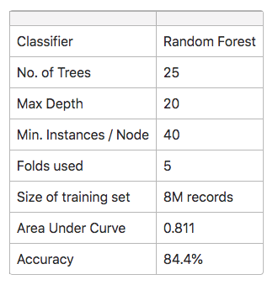
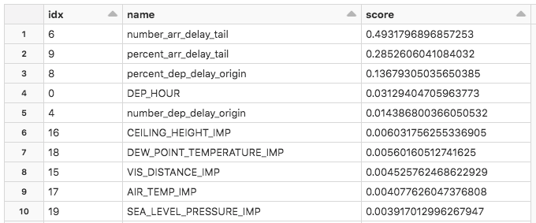
Final Model: Random Forest
Notes:
Mrinal

Slide 17
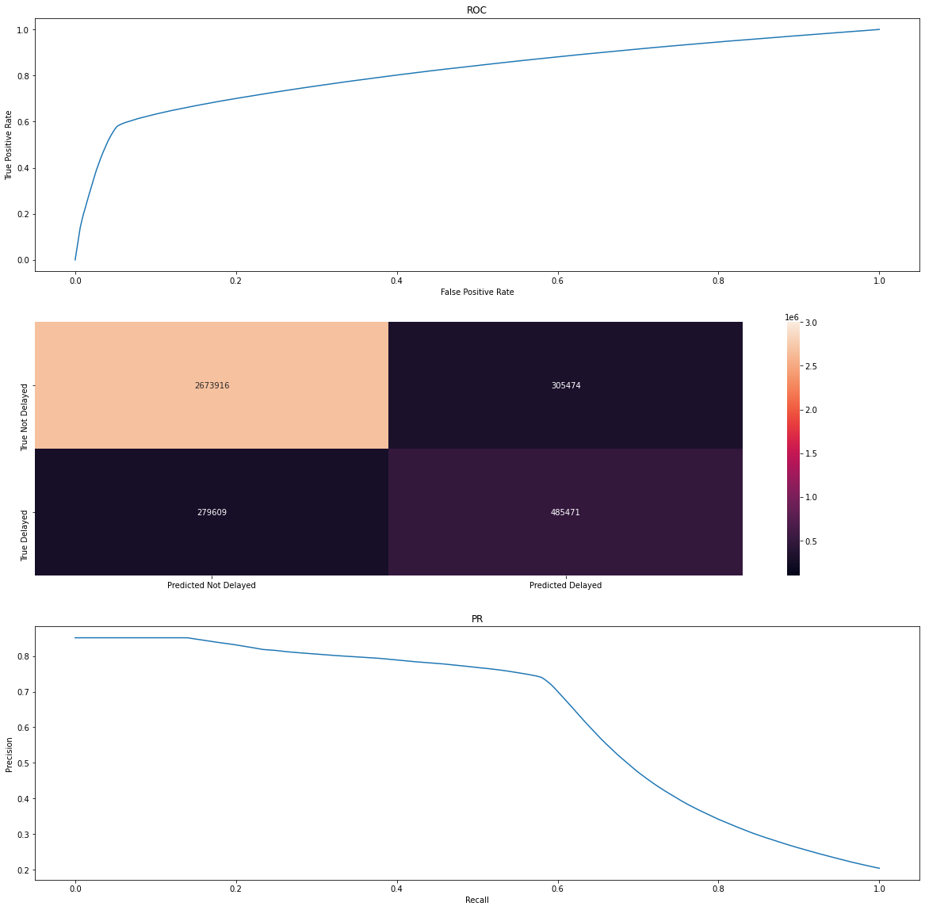
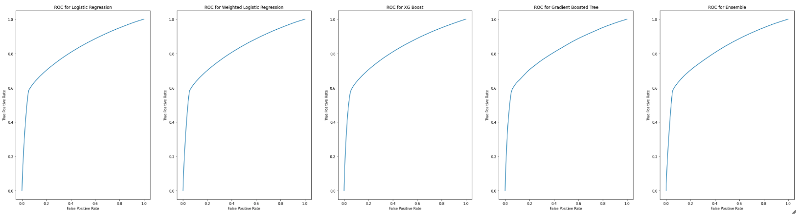
Final Model: Random Forest

Slide 18
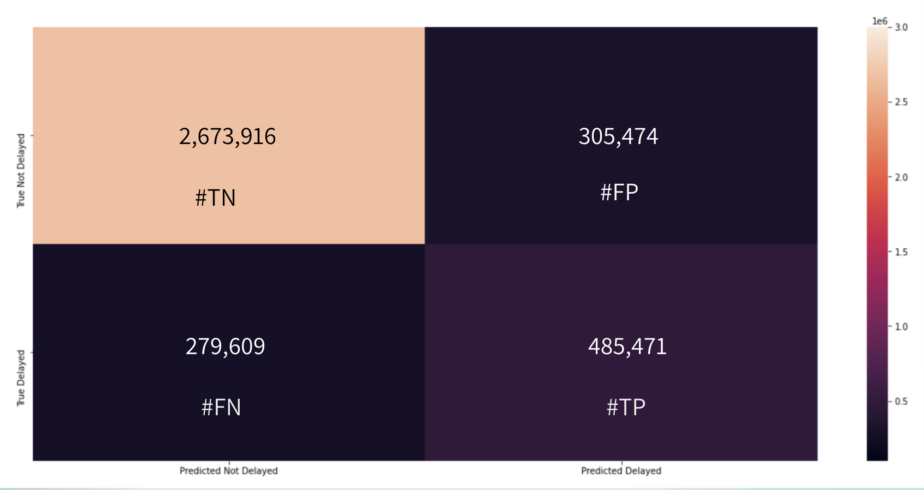
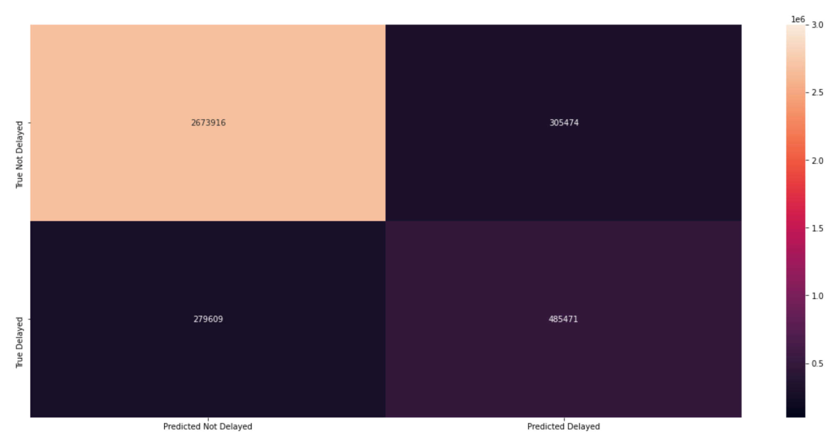




Confusion Matrix
2,673,916
305,474
#TN
#FP
279,609
485,471
#FN
#TP
Notes:
Sushant
What does this confusion matrix tell us ?
84% of the time, the model predicted delays and on time departures correctly.
About 7.5% of the time (bottom left box), the model predicted on time departure, but the flight actually got delayed - False Negative
This has the same effect as having no model at all.
About 8.1% of the time (top right box), the model predicted a delay, but the flight departed on time. - False Positive
These instances will beat the purpose of having a model and will impact customer experience the most
We examined these cases further…

Slide 19
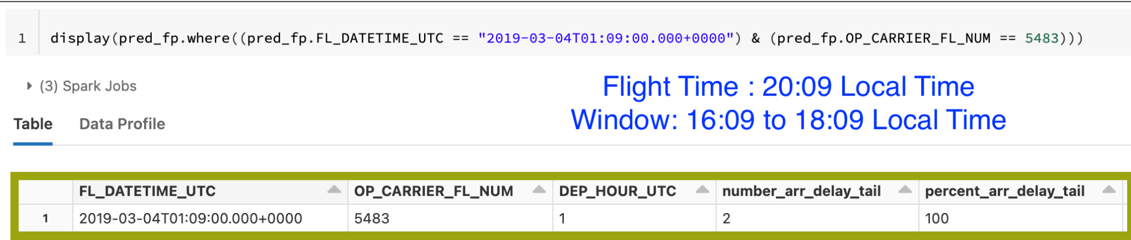
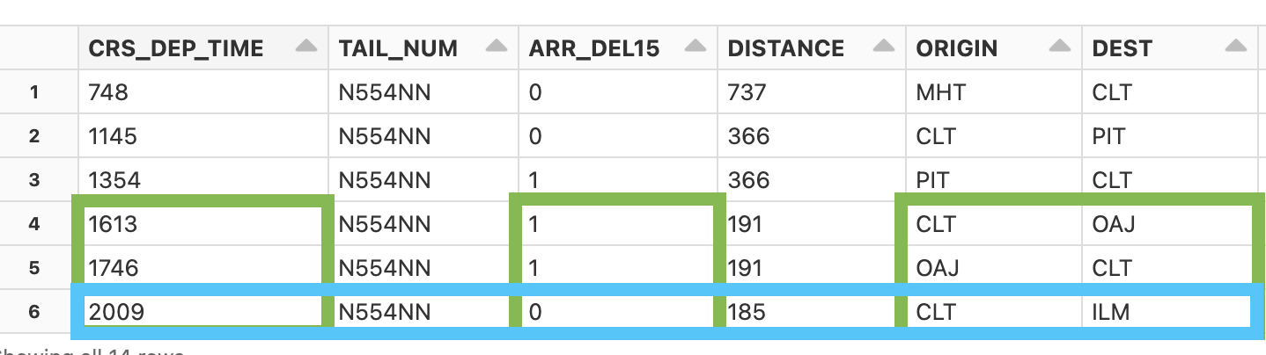
Classification Error - I
Notes:
Sample a record with the false positive
In this case, the departure time for the flight is 20:09 local time.
The features are telling us that there were 2 departure delays in the 2 hour window.
So, what really happened ?
For the route CLT to ILM to be on time, the prior arrival of the tail number should have been on time. But we see a delay from OAJ to CLT
The prior flight CLT to OAJ also has a delay. This matches with our feature data… Good
Lets look at the inferences
All these three routes are relatively short distances 191 and 185 miles.
Though the inbound flight arrived late, the flight still departed on time.
We seemingly need a feature then which will capture the MINIMUM RESTING PERIOD for the flight at the airport which can avoid the delay.
We actually introduced this feature and retrained our model with some positive improvements.. Ajeya will talk about this shortly…

Slide 20
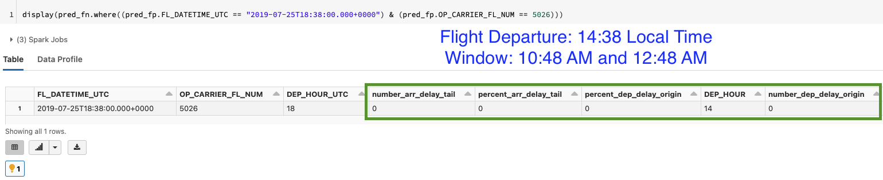
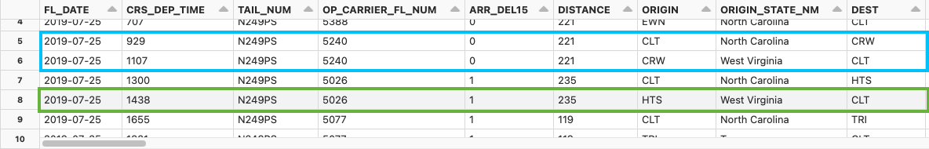
Classification Error - II
Notes:
This is an example of a False Negative
There is no flight arrival delays for the given tail number, there are also no departure delays at the origin.
Nothing extraordinary stands out in the weather.
Turns out that the actual arrival flight arrived after the prediction was made and it arrived late - Row #7
Window 10:48 AM to 12:48 PM Local Time

Slide 21
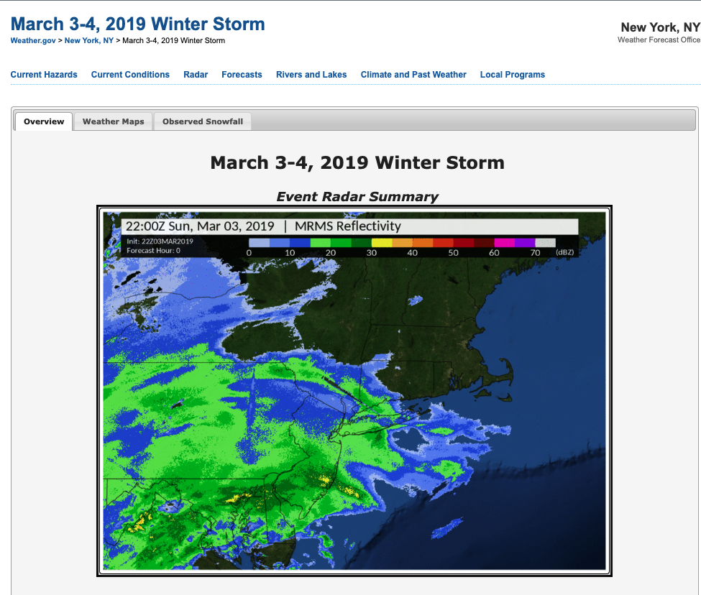
Other interesting insights
Case #3
Case #4
Predicted flight delay based on 25% of departing flights delayed at the given airport in the 2 hour window.
But, flight actually departed on time.
#FP
Model predicted on time departure based on 8 AM data for 10 AM departure time. However, the arriving flight arrived after model prediction time, resulting in a delay
#FN

Slide 22
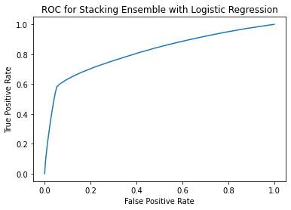
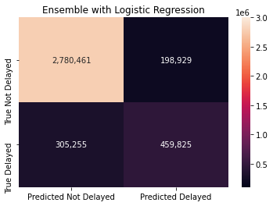
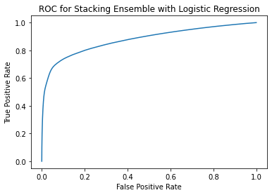
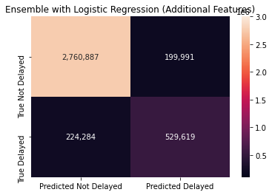
Post Error Analysis
Before
AUC: 0.8143
F1-Score: 0.6459
TN
FP
FN
TP
After
AUC: 0.8767
F1-Score: 0.7140
TN
FP
Added new features
1 .number_flights_carrier
2 .number_dep_delay_carrier
3. percent_dep_delay_carrier
4. Resting_time_tail_num
FN
TP
Notes:
Ajeya
Added new features
number_flights_carrier
number_dep_delay_carrier
percent_dep_delay_carrier
Resting_time_tail_num
We see that after adding these features, the ensemble with logistic regression as the meta or level 1 model has had a significant improvement in its scores, with AUC going up to .87 from .81 and F1-score going up to .71 from .64. The confusion matrix reveals that we managed to improve true positives and false negatives, while there was a small decrease in the true negative and false positives.

Slide 23
Limitations, Challenges & Scale/Performance
Limitations
Challenges
Feature reduction for all models
Extracting feature importance non-trivial in XGB, GBT, and Linear regression
Possible additional features
Weather at the destination
Tail number history to assess if a specific aircraft is prone to delay - ex. Older model
Origin-destination pair impact on delays
Model the carrier efficiency
Sub-optimal for short-duration flights
Specifically, flights of < 2 hours
EDA and missing data
Past average for missing weather data
Post-merge missing/null handling
Hyperparameter tuning with cross-validation
… time and resource consuming
Several tunables for each of the five models
Using weights for data imbalance
Model for weights was challenging
Inconsistent performance across folds
Not retaining additional data columns
Debug efficiency
Scale/Performance
Join Optimization - reduce number of joins
Reduce CV complexity
Notes:
Kumar

Slide 24

Next Steps
Notes:
Kumar
Extend Error Analysis exercise to establish concrete patterns in errors.
Feature Engineering
Weather at destination, specially for short duration flights.
Weather forecast params
Airline, Carrier and Tail Number specific features
ML Techniques
Consider re-evaluating Tree Based Models without applying One Hot Encoding knowing the potential downsides of OHE for such models.
Consider building models specific to distinct geographies across US.
Graph based modeling
Consider evaluation of graph model based on delay network to take into account the propagation effects of delays due to airline, flight, or extreme weather conditions at different geographical locations across the nation.
Additional feature engineering
Possible integration with services such as FlightAware
Forward time-window based training on models

Slide 25
Thanks

Slide 26
AGENDA
Business Case
Datasets
EDA and Feature Engineering
Algorithms
Cross Validation and Evaluation
Performance and Scalability
Notes:
Mrinal

Slide 27
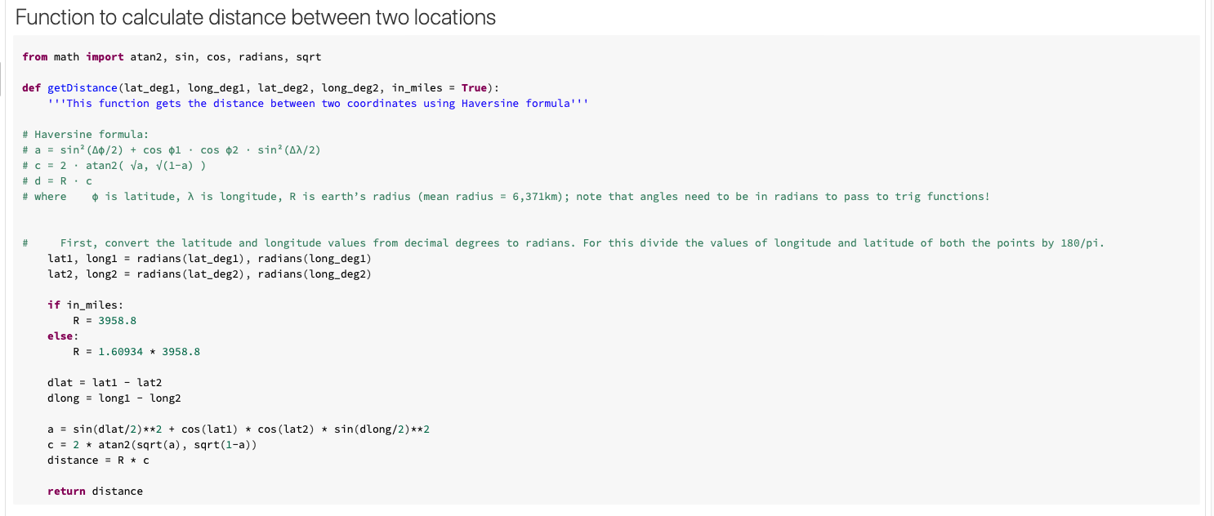
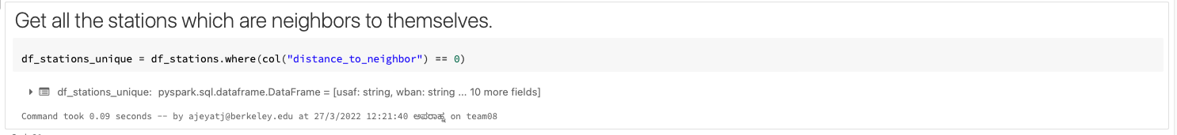
Workflow in action
Notes:
Sushant

Slide 28
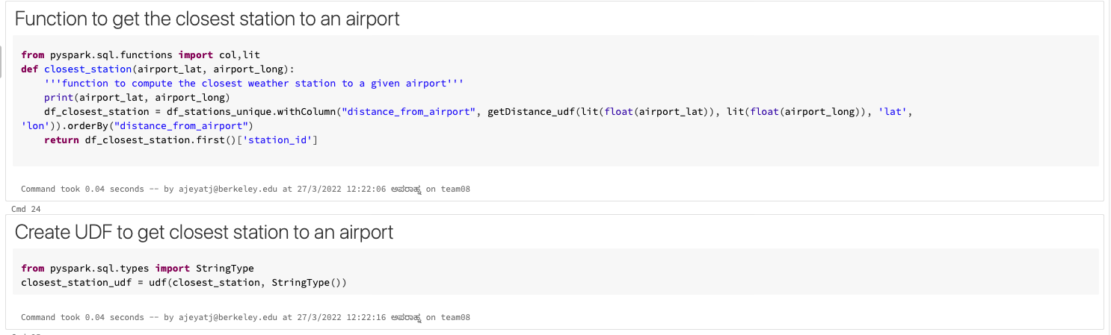
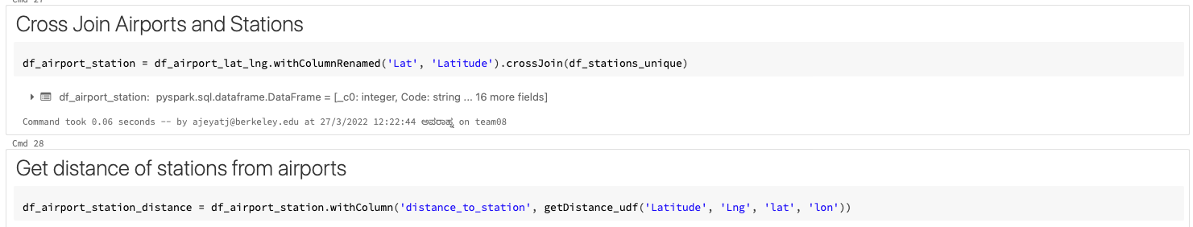
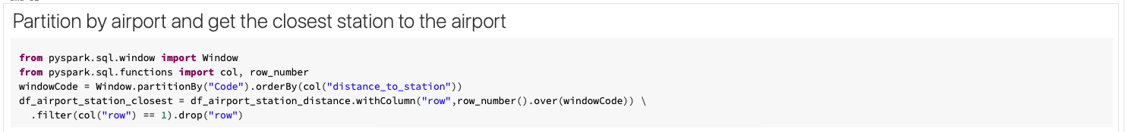
Workflow in action
Notes:
Sushant

Slide 29
Model - Logistic Regression
Logistic Regression
Data scale
Parameters for binary classification
elasticNetParam=0.5
aggregationDepth=8
standardization=False
weightCol=”WEIGHT”
Standardization handled in test-train gen
Test-train split - 0.725/0 .275 or 0.8/0.2
3 different run of LR
sample no_delay rows of merged data
sample no_delay rows after filter
weights for minority and majority class
Merged data
~13.3M delayed departures
~55.5M on-time departures
After removal of “ELEVATION == NULL”
termed prepared_data
~4.3M delayed departures
~19.6M on-time departures
2019 data F1: 0.34(sampled), 0.334(weighted)
Sample merged data
Sample prepared data
Weight feature
F1-Tr | # delay | # no_delay
0.49 | 4.3M | 5.0M
0.40 | 4.3M | 8.9M
0.005 | 4.3M | 12.0M
0.001 | 4.3M | 14.4M
F1-Tr | # delay | # no_delay
0.57 | 4.3M | 4.3M
0.33 | 4.3M | 5.8M
0.15 | 4.3M | 7.4M
0.06 | 4.3M | 8.9M
F1-Tr | # delay | # no_delay
0.33 | 13.3M | 55.5M
weight_delay = 2.77
Total/(num_delay *2)
weight_no_delay = 0.61
Total/(num_no_delay *2)
No Weights
F1 | # delay | # no_delay
0.0007 | 13.3M | 55.5M
Notes:
Kumar
Show ROC curve
Compare to a baseline model (guess majority)
Do the debugging, why is the model not performing well, etc.

Slide 30
Logistic Regression - Discussion
Data skew has significant impact on the regression model
The data set is inherently skewed
Can’t complain that on-time departures are significantly more that delayed departures
Lowering the threshold improves the F1 score
Lowered threshold impacts precision-recall tradeoff
… doesn’t result in a better model
Down-sample of majority (on-time departures) provides the most optimal solution
Weighting the minority class data
new feature - constant weight for all minority class and a different lower weight for majority class
seems to significantly improve F1 score
needs investigation - F1 score look too good to be true
SMOTE - Synthetic Minority Oversampling Technique
way to oversample minority class by selecting samples “close” in feature space, drawing a line between these samples, and selecting point on that line
1st choose a random minority sample, get k-NN, choose one of the k-NN, select sample on the line
very high run time, and no good result.
Notes:
Kumar

Slide 31
Model - Decision Tree
Data
Dropped rows missing weather data
Downsampled majority class
50-50 split
80 / 20 Train-Test split
Based on date
7.8M record total
Features
Recency of weather features
Average of 2 hour window
Tuned hyperparameters
Minimum instances per node: 50
maxDepth : 29
Joined Dataset (68M)
Drop columns used for join
Drop Rows with missing Delay info
Aggregate weather records in window
(23.9M)
Drop rows missing weather
Assemble into Feature Vector
Downsample (7.8M)
Train Model
Notes:
Mrinal
Use Random forest

Slide 32
Decision Tree - Discussions
Results
F1-Score training: 0.55
F1-Score test : 0.32
Predictive Power
Include airport features
Reduce weather features
Generalization
Reduce weather features
Reduce range for hyper parameter tuning
Predictions for flights missing weather data

Slide 33
Performance
Time required to join the Full Data Set | 7 hours
Time required to train Decision Tree | 20 min.
Time required to train Logistic Regression | 18 min.
Number of records in training set (2015 to 2018) | 8M
Best F1 score so far | 0.32(DT), 0.34(LR)
Notes:
Mrinal

